Slide 1
INTRODUCTION

Slide 2
“Discovery is no longer limited by the collection and processing of data, but rather management, analysis, and visualization.”
@DamianMingle

Slide 3
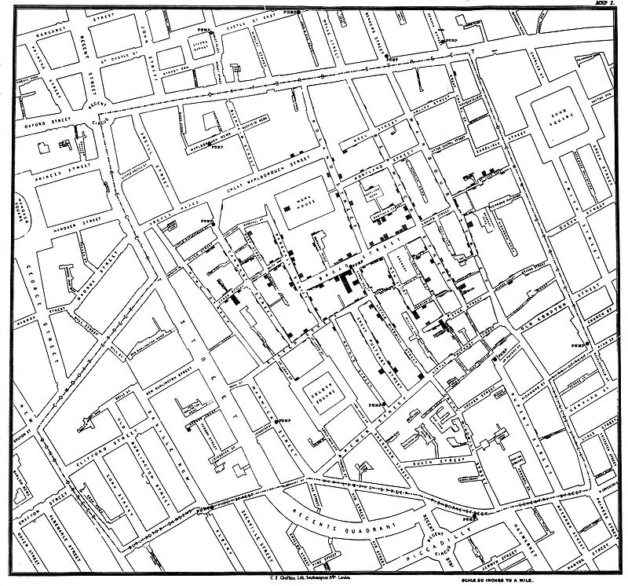
London’s Cholera Outbreak of 1854
Physician John Snow links the outbreak to a contaminated well by plotting number of cases on a map, jump-starting the science of epidemiology.

Slide 4

[Minard, 1869]
Minard’s March to Moscow

Slide 5
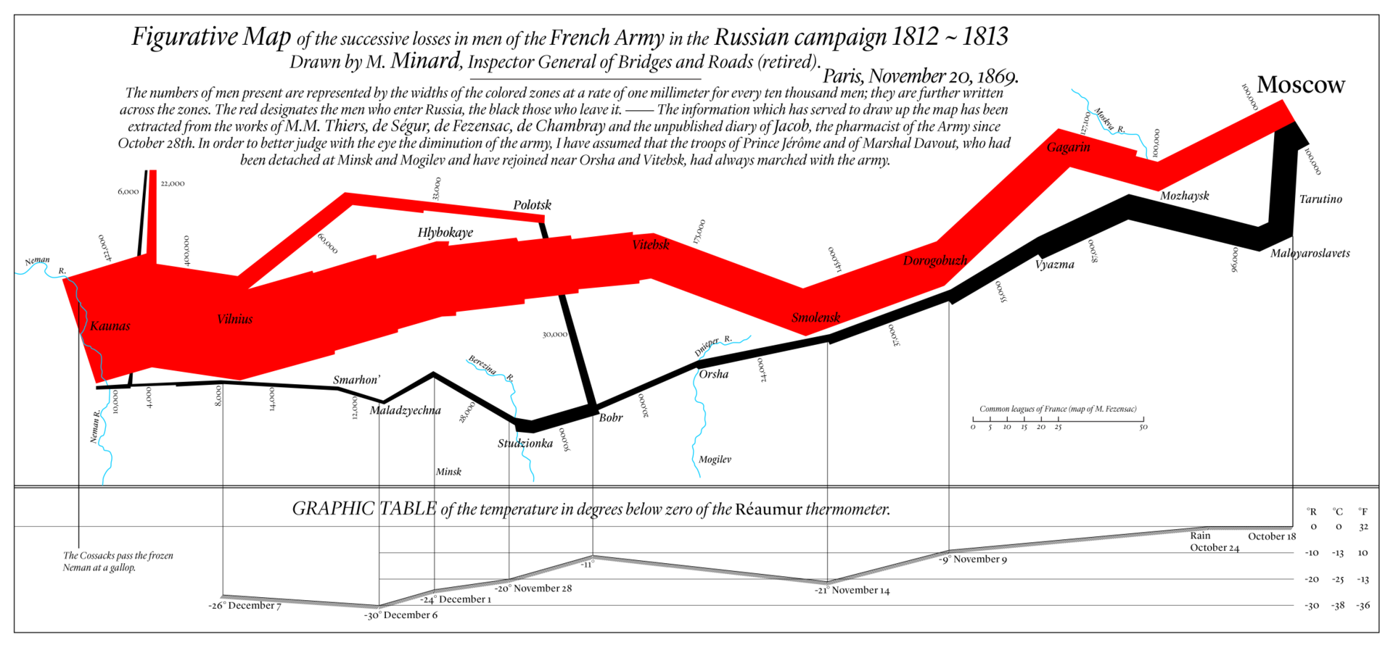
[DAL Podcast #3 – https://youtu.be/tS_2_IQ5gRw]
Minard’s March to Moscow

Slide 6
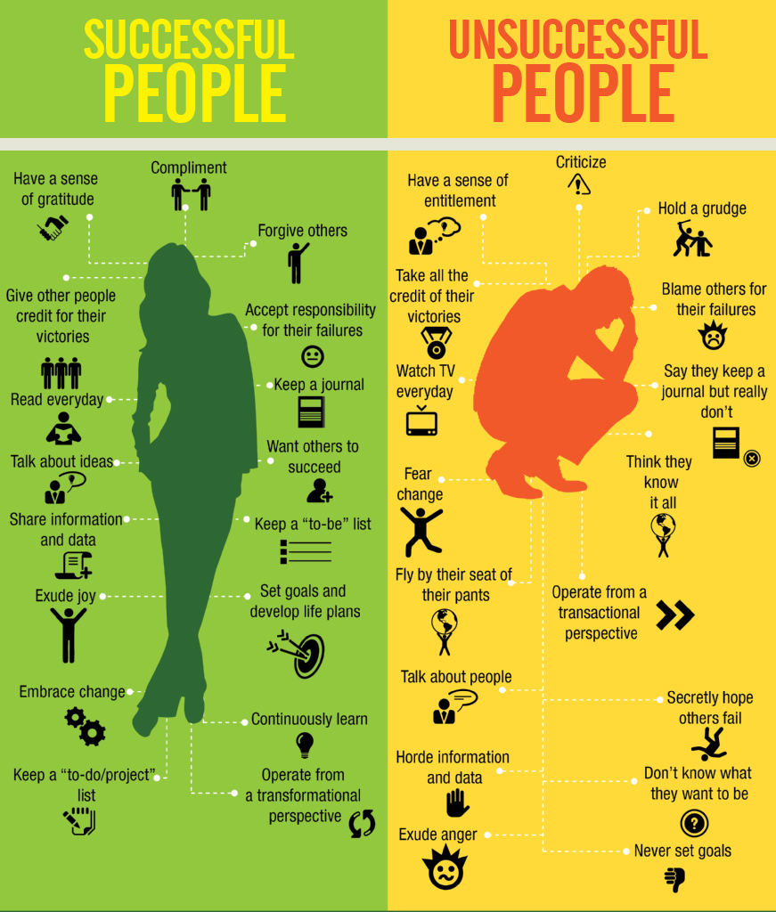
Infographics
[J.P. Blackard]
Created for story-telling purposes (subjective)
Intended for a specific audience
Self-contained and discrete
Graphic design aspect is key
Cannot usually be re-used with other data
Can incorporate unquantifiable information

Slide 7
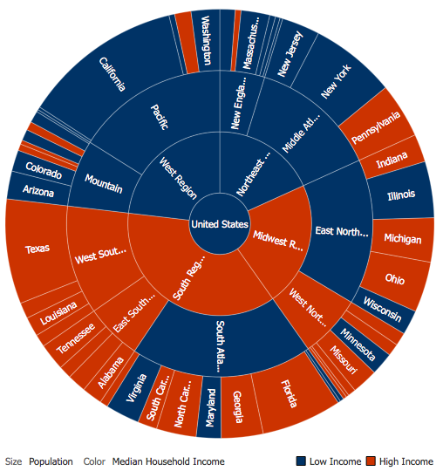
Data Visualization
[Author unknown]
A method, as well as an item (objective)
Typically focuses on the quantifiable
Used to make sense of the data or to make it accessible (datasets can be massive and unwieldy)
May be generated automatically
The look and feel are less important than the insights conveyed by the data

Slide 8
DATA UP TO the 20tH CENTURY
In the 20th century, data problems were mostly related to
engineering (design of machines)
sciences (formulation of theories)
Problems were solved empirically, theoretically, or through computation.

Slide 9
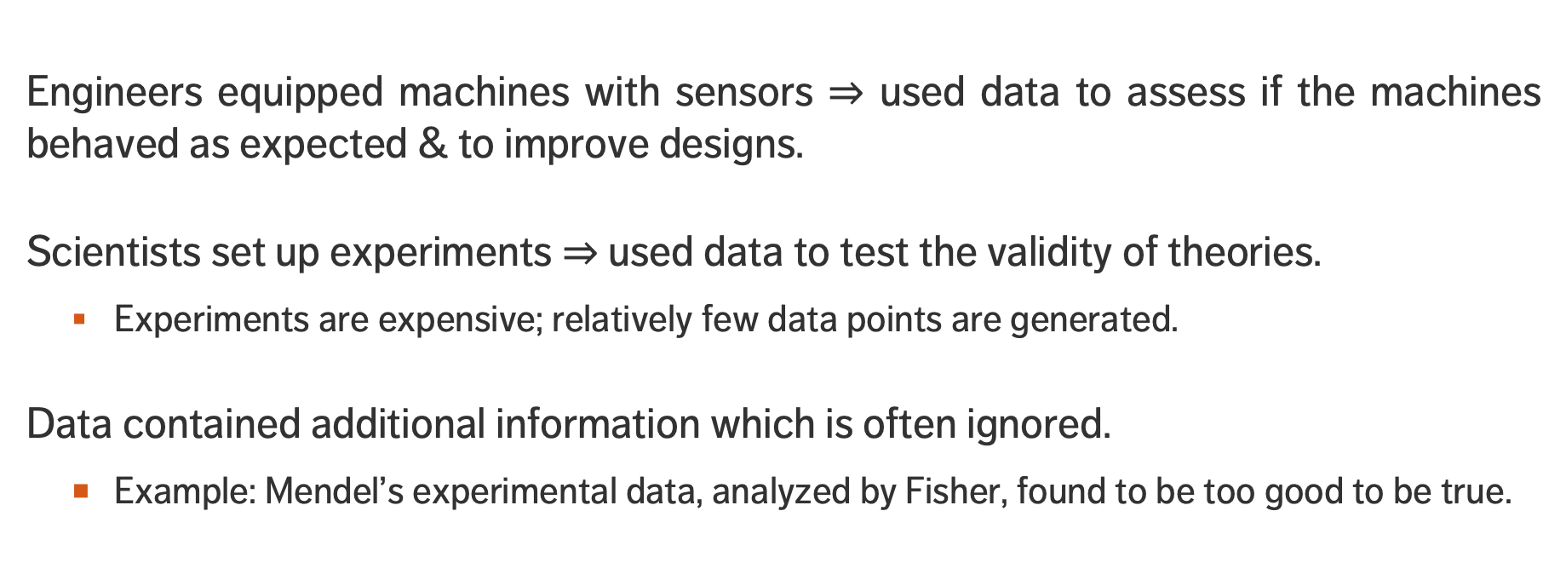
DATA UP TO the 20tH CENTURY
Engineers equipped machines with sensors $⇒$ used data to assess if the machines behaved as expected & to improve designs.
Scientists set up experiments $⇒$ used data to test the validity of theories.
Experiments are expensive; relatively few data points are generated.
Data contained additional information which is often ignored.
Example: Mendel’s experimental data, analyzed by Fisher, found to be too good to be true.

Slide 10
DATA in the 21st CENTURY
In the 21st century, there is:
there is more data
it’s mostly digital
it’s mostly observed (rather than generated by designed experiment)
Problems are solved empirically, theoretically, through computation and/or data exploration/visualization.

Slide 11
DATA in the 21st CENTURY
Empirically: observe and describe what happens
Theoretically: generalize and build models and generalizations to understand what happens
Computationally: design computer simulations to better understand what happens
Data Exploration/Visualization: the new approach to understanding

Slide 12
EXERCISE
In teams or individually, identify a few data visualizations that appeal to you (professionally, esthetically, or both).
What is the story being told by the visualization?
What kind of data is needed to build these visualizations?

Slide 13
The (Messy) Analysis Process
Objective/
Rationale
Utilization and Decision Support
Data Collection
Data Exploration
Infrastructure and Data Management
Data Preparation
Modeling and Analysis
Communication

Slide 14




















DATA Environment
Data storage
Data collection
Extract TransformLoad
Visualization generation
Data preparation
Data warehouse
Data analysis
Results integration
Visualizations account for only $\sim 10\%$of the process.

Slide 15
EXERCISE
In teams or individually, identify work scenarios for which data visualization could prove useful.
What insight could be drawn from such visualizations?
Would such visualizations get a buy-in from your supervisors/employers?
How much work would be required to get from design to completion? Are the obstacles mostly of a technical nature? Related to data procurement?

Slide 16
VISUALIZATION AND DATA EXPLORATION

Slide 17
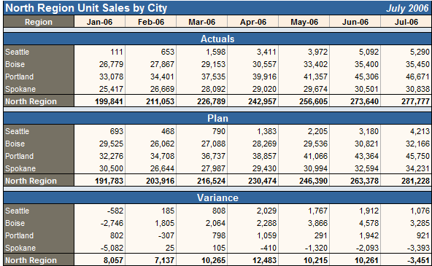
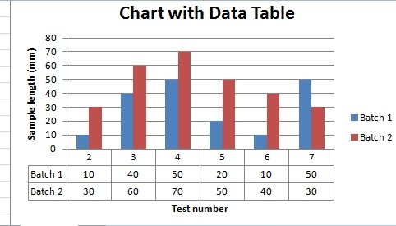
OVERVIEW
The past is data-driven:
mostly Excel (or reporting tools like Cognos)
mostly numbers, tables and non-interactive graphs
distributed on desktop computers, by email, in PowerPoint presentation
static, mostly backwards looking (lagging indicators)
KPIs and dashboards were somewhat contrived

Slide 18
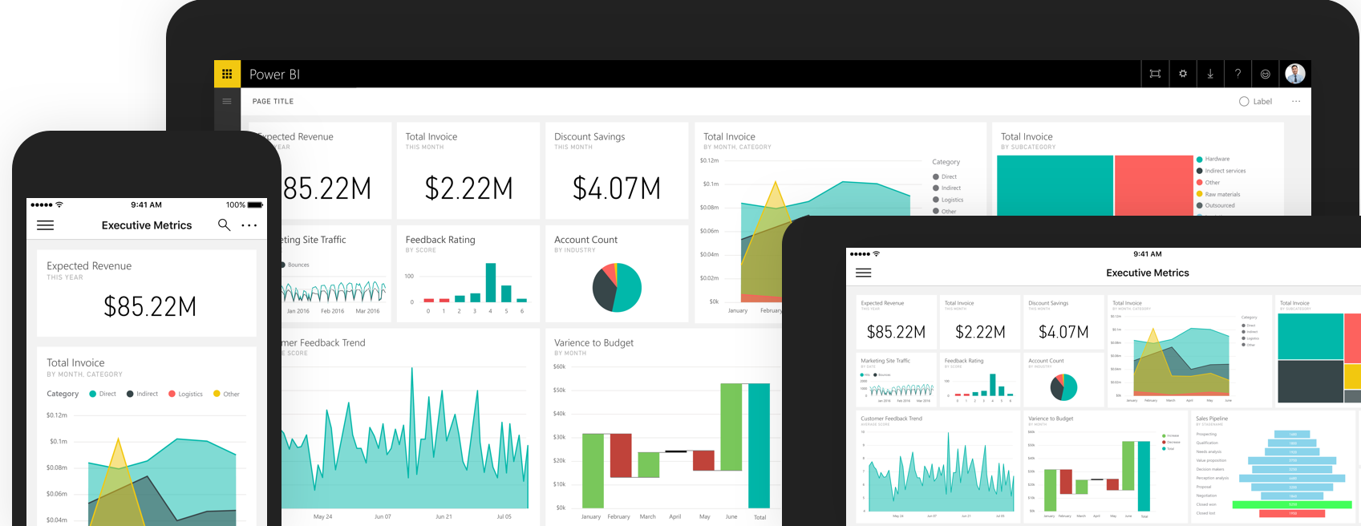
OVERVIEW
The future is story-driven:
new tools: Power BI, R, Qlickview etc.
mostly visualizations, occasional numbers and tables
distributed on the web (internal and external)
dynamic and both backwards and forwards looking (leading and lagging indicators)
data for everyone

Slide 19
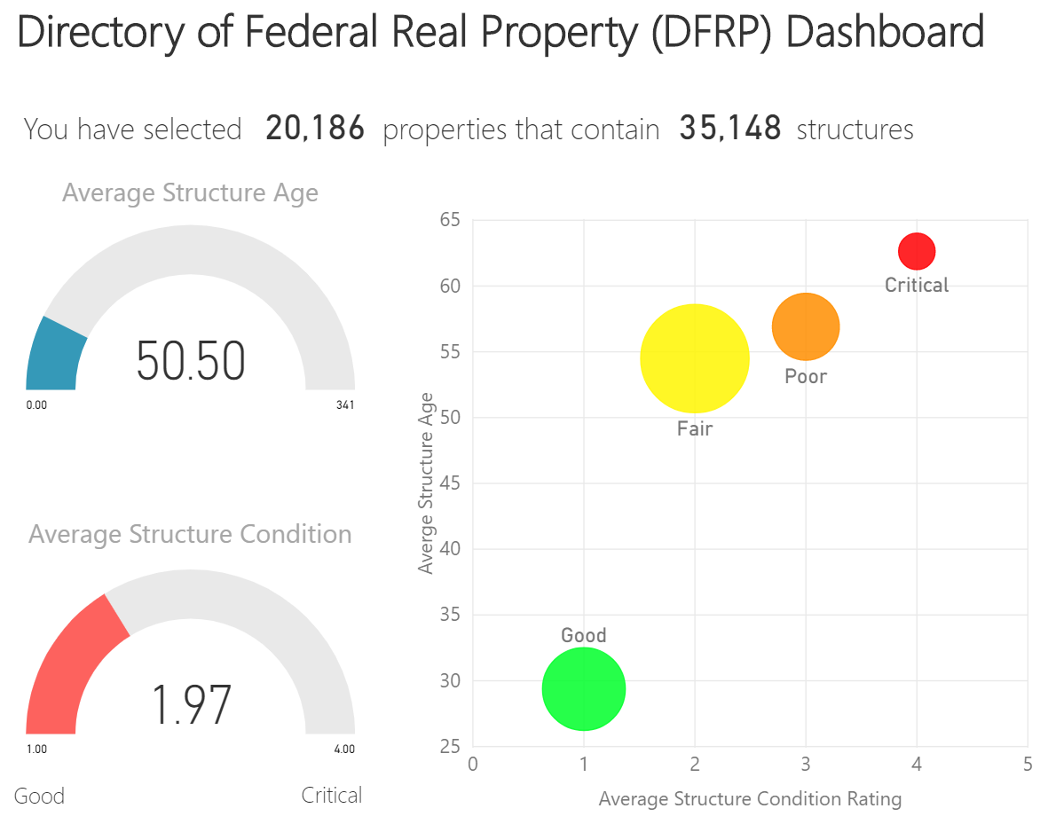
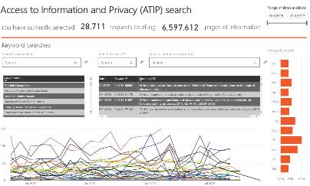
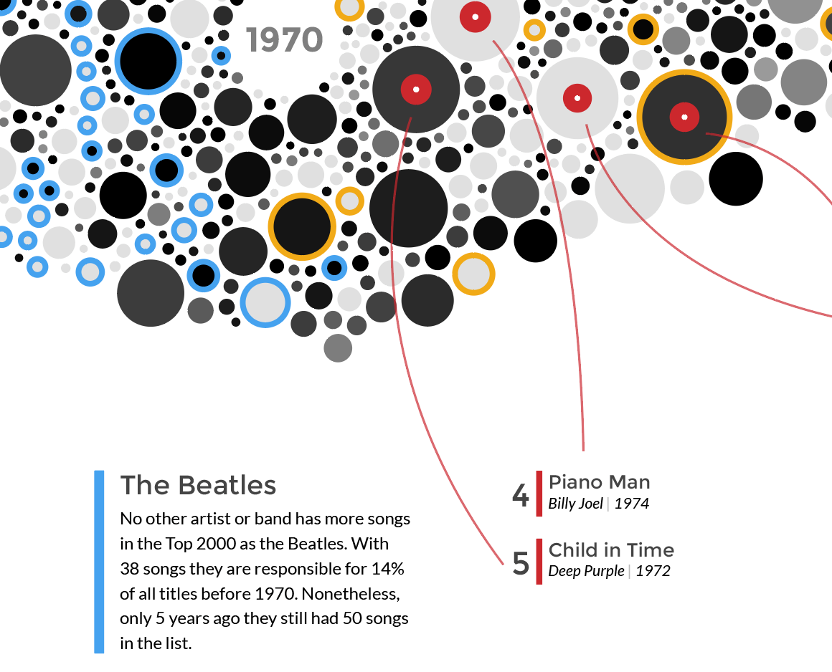
Defining Context
Seconds
Minutes
Fraction of Hour
Hours
Infographics/Data Viz
Dashboards
Reports
Data Art

Slide 20
EXPLORATORY VS. EXPLANATORY ANALYSIS
Exploratory: understanding the DATA (associated with reports)
Explanatory: communicating a STORY (associated with dashboards and data viz)
VS.
Exploratory
Explanatory

Slide 21
Some Basic Questions
What system does your data represent – objects, attributes, relationships?
How does it represent this system – i.e. the data model?
Who made this dataset? When? For what purpose?
Assuming a flat file – what do the rows represent? What do the columns represent?
Do you even have enough information (e.g. metadata) to answer these questions? Where can you find more information?

Slide 22
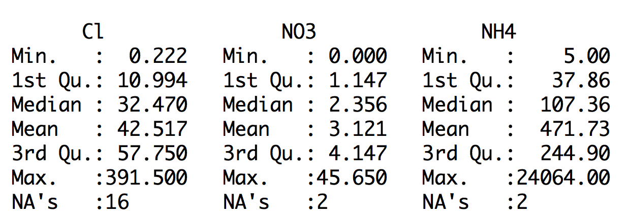
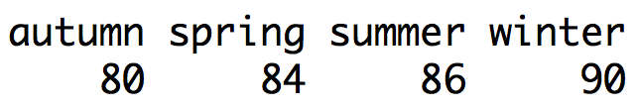
Non-Visualization Based Summaries of Your Dataset

Slide 23
Pre-Analysis Use
Data visualization can be used to set the stage for analysis:
detecting anomalous entries invalid entries, missing values, outliers
shaping the data transformations binning, standardization, Box-Cox transformations, PCA-like transformations
getting a sense for the data data analysis as an art form, exploratory analysis
identifying hidden data structure clustering, associations, patterns informing the next stage of analysis

Slide 24
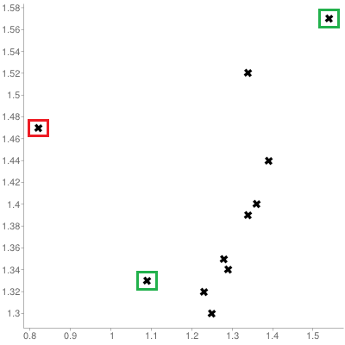
[Personal dataset]
Customers served at counter (per minute)
Customer arrivals at counter (per minute)

Slide 25
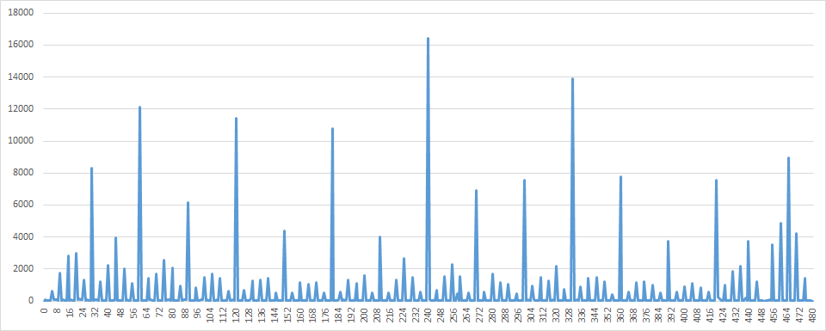
Pre-Analysis Use vs. Post-Analysis Use HEAPING DATA – SELF-REPORTING WORK HOURS
[Personal dataset]
Self-reported work hours (mins)

Slide 26
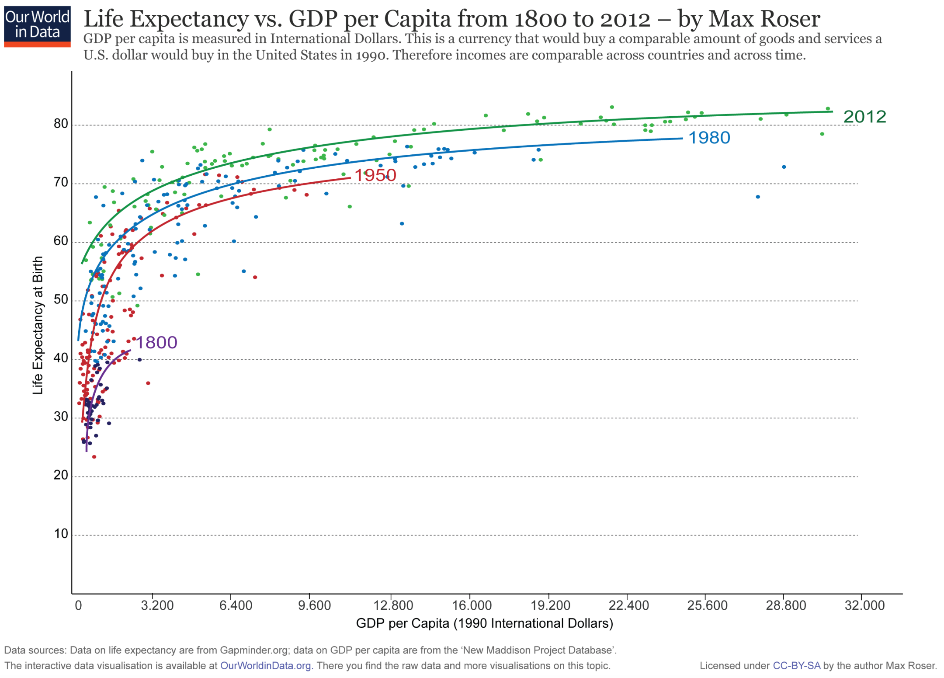
[https://ourworldindata.org/life-expectancy]
This graph displays the correlation between life expectancy and GDP per capita.
Countries with higher GDP have a higher life expectancy, in general.
The relationship seems to follow a logarithmic trend: the unit increase in life expectancy per unit increase in GDP decreases as GDP per capita increases.

Slide 27
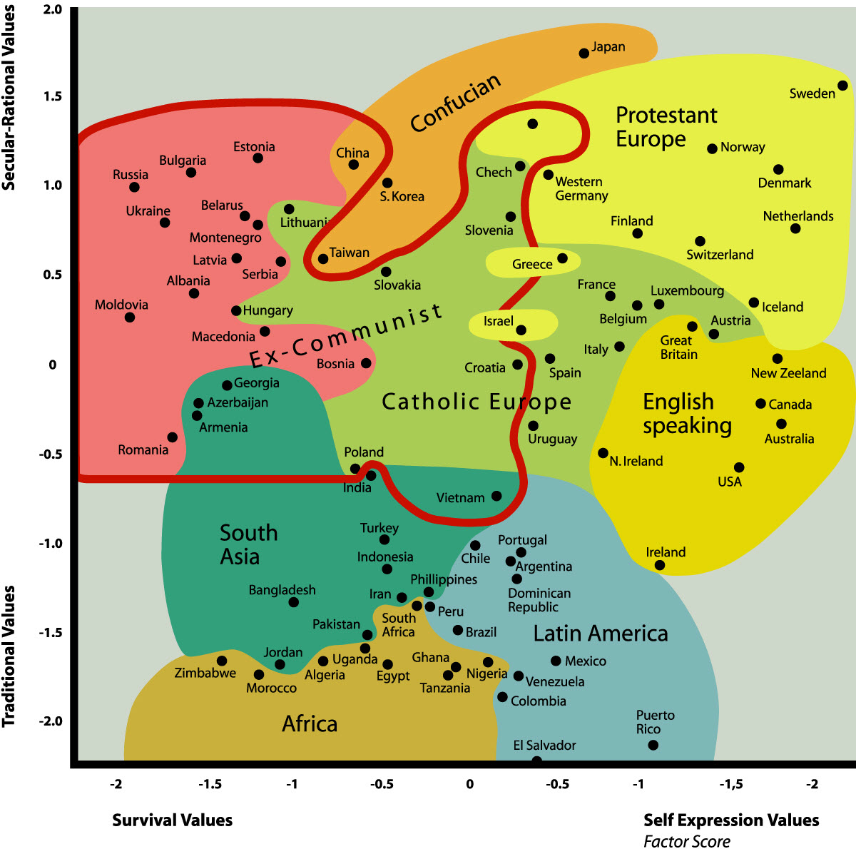
Inglehart-Welzel's Global Cultural Map (2010-2014)
[https://en.wikipedia.org/wiki/World_Values_Survey]
Traditional values importance of religion, parent-child ties, deference to authority and traditional family values.
Secular-rational values less emphasis on religion, traditional family values and authority.
Survival values emphasis on economic and physical security.
Self-expression values high priority to environmental protection, growing tolerance of foreigners, gays and lesbians and gender equality

Slide 28
DISCUSSION
Which of the pre-analysis uses of visualization is most relevant to your work?

Slide 29
BASICS OF DASHBOARDING

Slide 30
Reporting and Deployment
An analysis can only be as good as how it is communicated and/or deployed.
Crucial Questions:
Who is in receipt of the report(s)?
How are the workflows deployed into production?
Can data insights be turned into useful policies?
Automatic reporting should be audited and validated regularly.

Slide 31
Reporting and Deployment
Communication should occur at various stages of the project, not solely upon completion:
keep sponsors / clients aware of broad lines
technical details may be avoided, but documented nonetheless
Ideal scenario: analysis software is also reporting software
minimizes human error related to cut-and-paste
removes the need for keeping analysis and reporting separate
makes sharing the work with other project member easier
Simplify the process further by deploying directly to the Web.

Slide 32
DISCUSSION
What are your favourite reporting tools?
How much should you test a product before deployment?
What’s the cost of deploying a faulty product?
Notes:
Intro to text analysis
We will be talking about data reduction using NHL game between Ottawa Senators vs. Toronto Maple Leafs on February 18th of 2017

Slide 33
Dashboards
[Wexler, Shaffer, Cotgreave, The Big Book of Dashboards]
A dashboard is any visual display of data used to monitor conditions and/or facilitate understanding.
Examples:
interactive display that allows people to explore motor insurance claims by city, province, driver age, etc.
PDF showing key audit metrics that gets e-mailed to a Department’s DG on a weekly basis.
wall-mounted screen that shows call centre statistics in real-time.
mobile app that allow hospital administrators to review wait times on an hourly- and daily-basis for the current year and the previous year.

Slide 34
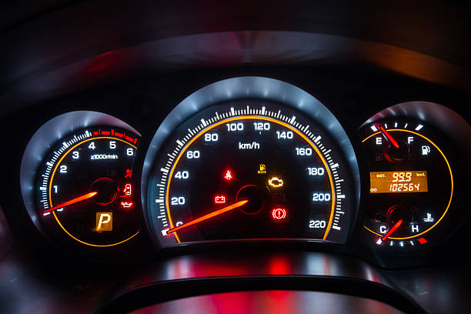
Some Questions To Consider
In a car’s dashboard, a small number of key indicators (speed, gasoline level, lights, etc.) need to be understood at a glance. A dashboard design that does not take these two characteristics under consideration can have catastrophic consequences.
The following questions need to be answered prior to the dashboard being designed:
Who is the dashboard’s consumer?
What story does the dashboard tell?
What data (categories) will be used?
What will appear on the dashboard?
How can the dashboard help the consumer?

Slide 35
DASHBOARD DESIGN Guidelines
[https://www.geckoboard.com/blog/building-great-dashboards-6-golden-rules-to-successful-dashboard-design]
Nick Smith suggests the following 6 Golden Rules:
Consider the audience (who are you trying to inform? does the DG really need to know that the servers are operating at 88% capacity?)
Select the right type of dashboard (operational, strategic/executive, analytical)
Group data logically, use space wisely (split functional areas: product, sales/marketing, finance, people, etc.)
Make the data relevant to the audience (scope and reach of data, different dashboards for different departments, etc.)
Avoid cluttering the dashboard (present the most important metrics only)
Refresh your data at the right frequency (real-time, daily, weekly, monthly, etc. )

Slide 36
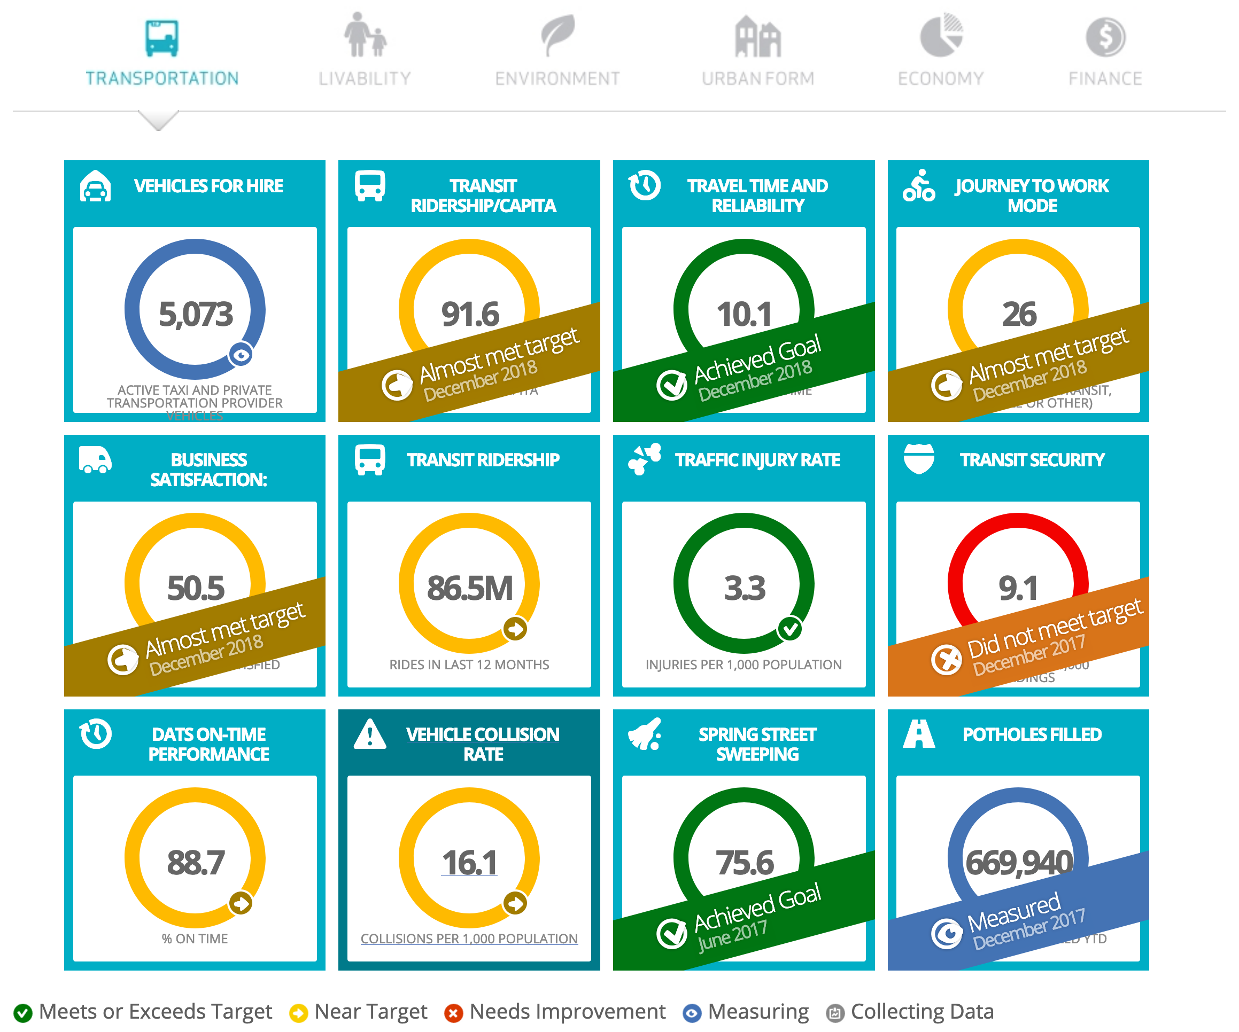
[https://dashboard.edmonton.ca]

Slide 37
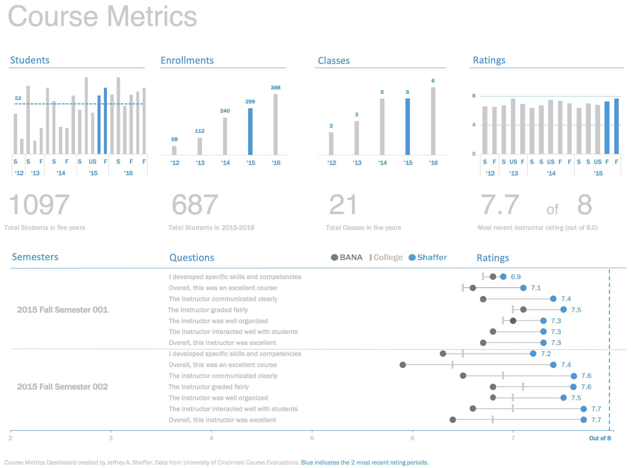
[https://bigbookofdashboards.com/dashboards.html]
Notes:
https://bigbookofdashboards.com/dashboards.html

Slide 38
Course Metrics Dashboard – Strengths
[Wexler, Shaffer, Cotgreave, The Big Book of Dashboards]
Easy-to-see key metrics
Simple color scheme
Potential to be static or interactive
Both overview and details are clear

Slide 39
DISCUSSION
There are no perfect dashboards – no collection of charts will ever suit everyone who encounters it.
All dashboards should be truthful and functional, but dashboards that are also elegant (delightful, enjoyable) will take you further.
All dashboards are incomplete. Good dashboards will still lead to dead ends, but they should allow users to ask: “Why? What is the root cause of a problem?”
Tools: Excel, Power BI, Tableau, R + Shiny, Geckoboard, Matillion, etc.

Slide 40
eXERCISE
Consider the following dashboards. Can you figure out, at a glance, who their audience is? What are their strengths? What are their limitations?
How could you improve them?

Slide 41
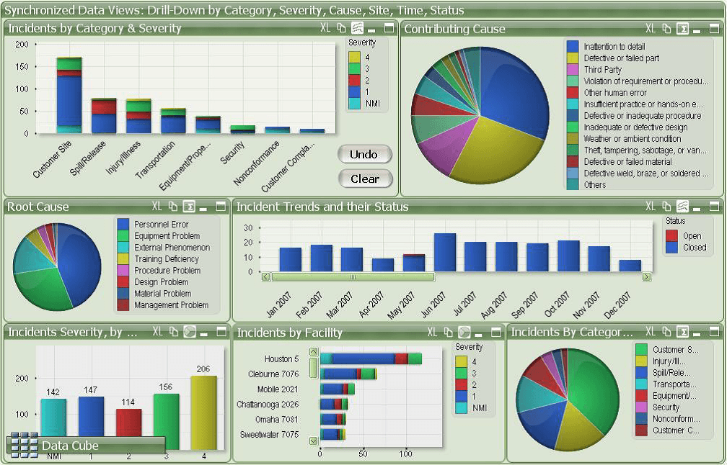
[https://www.matillion.com/wp-content/uploads/2014/11/qlikview-poor-use-of-dashboard-software.png]
Notes:
https://bigbookofdashboards.com/dashboards.html

Slide 42
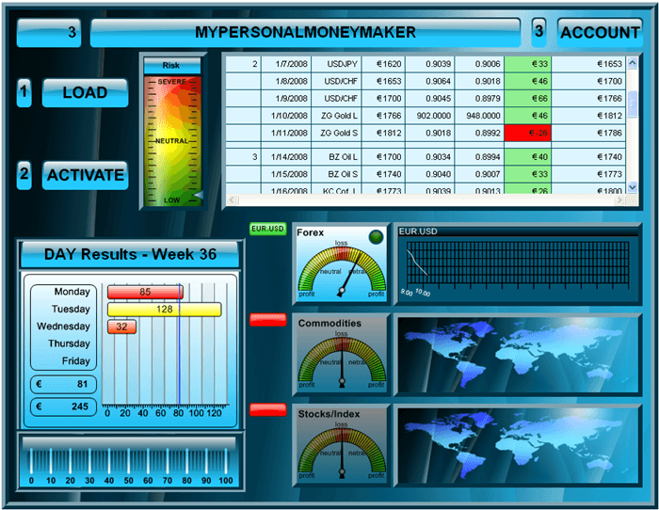
[https://www.geckoboard.com/assets/2-terrible-dashboard-example-min.png]
Notes:
https://bigbookofdashboards.com/dashboards.html

Slide 43
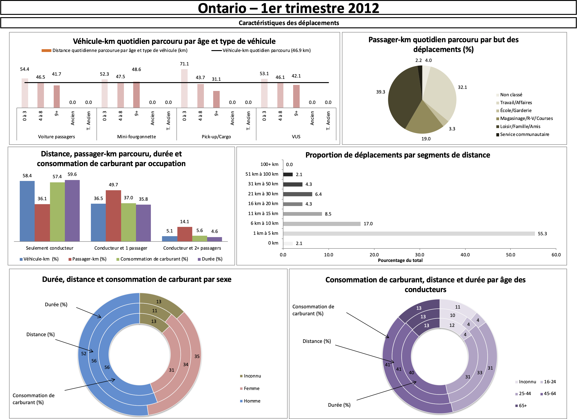
[Personal file]
Notes:
https://bigbookofdashboards.com/dashboards.html

Slide 44
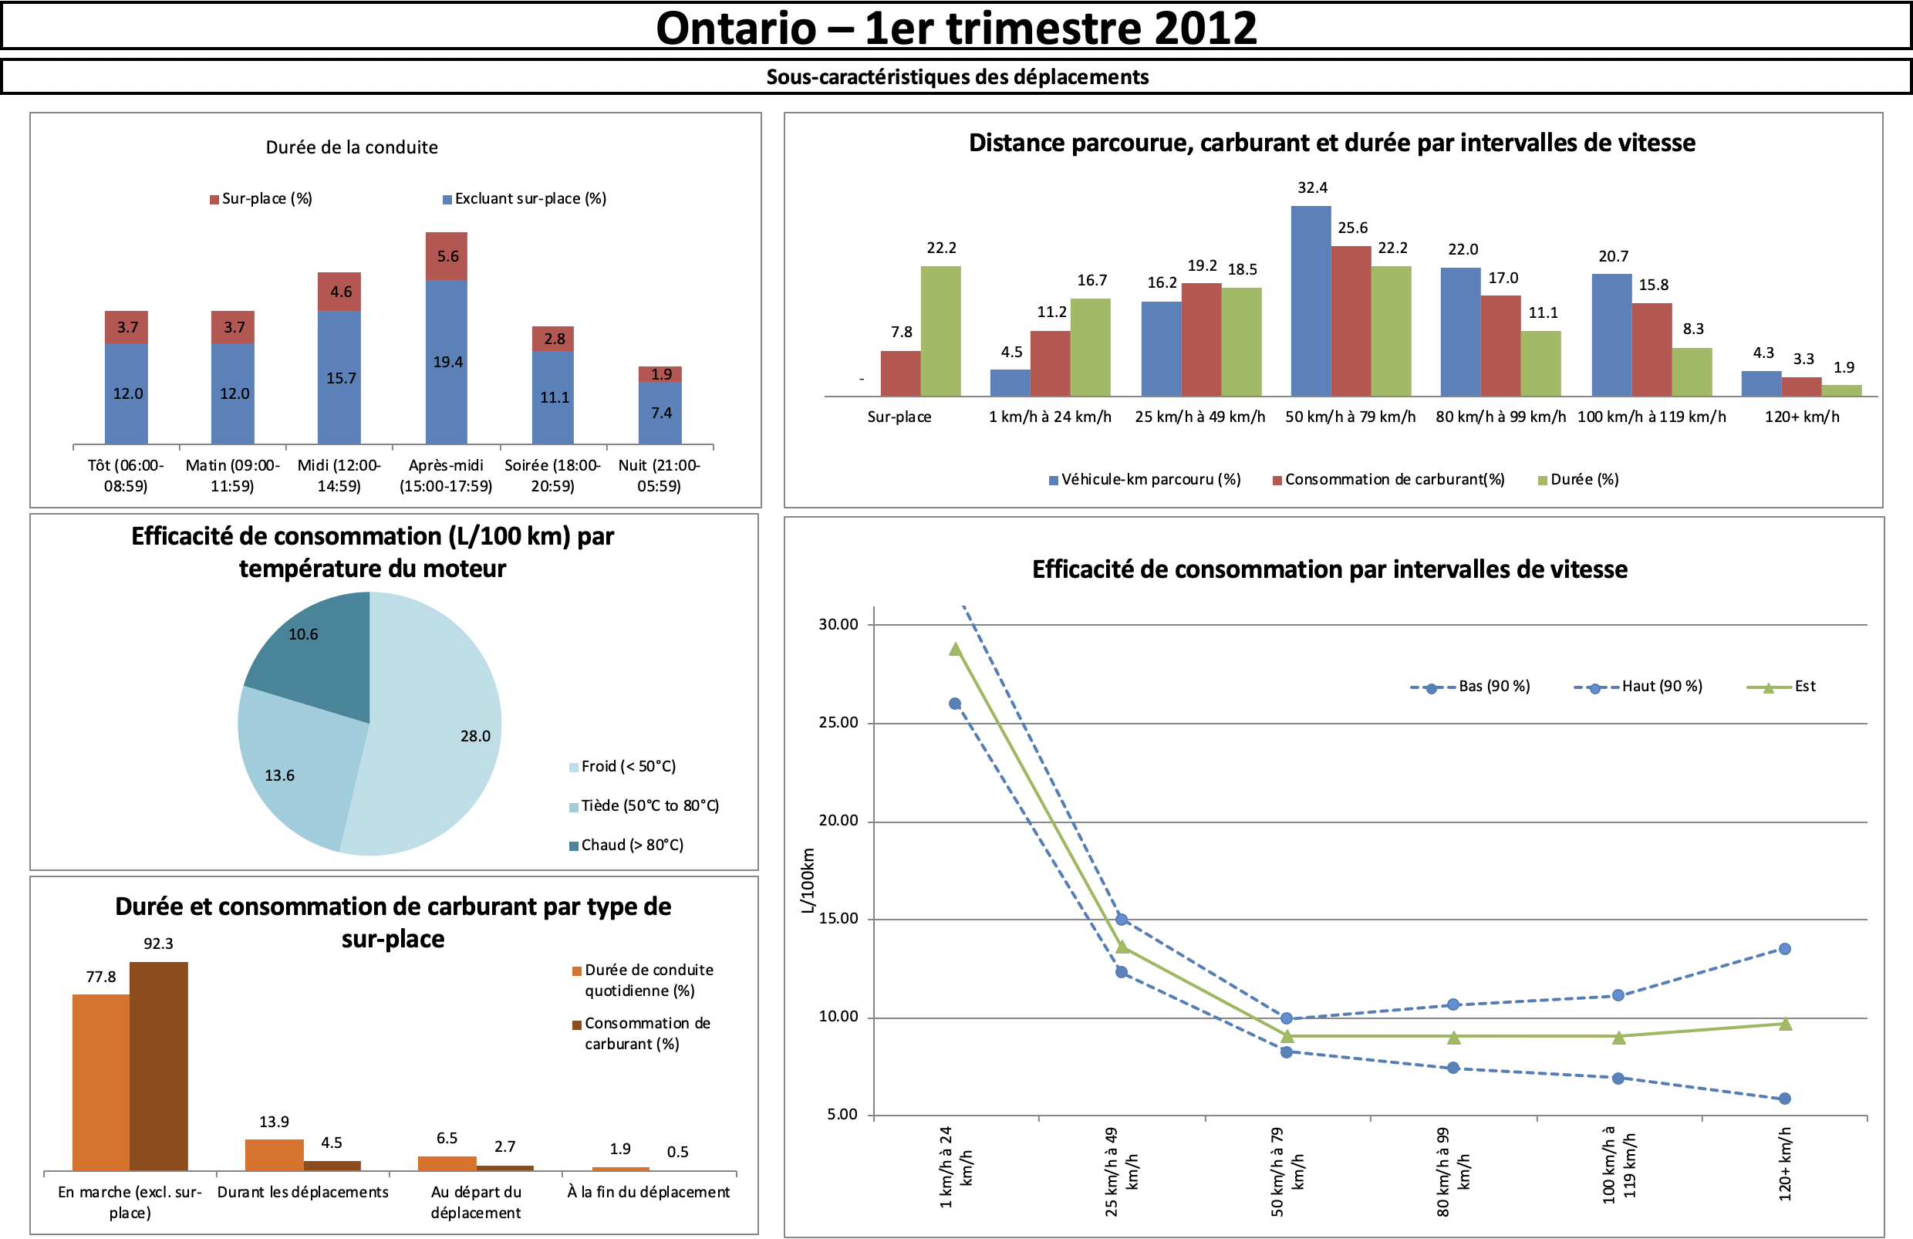
[Personal file]
Notes:
https://bigbookofdashboards.com/dashboards.html

Slide 45
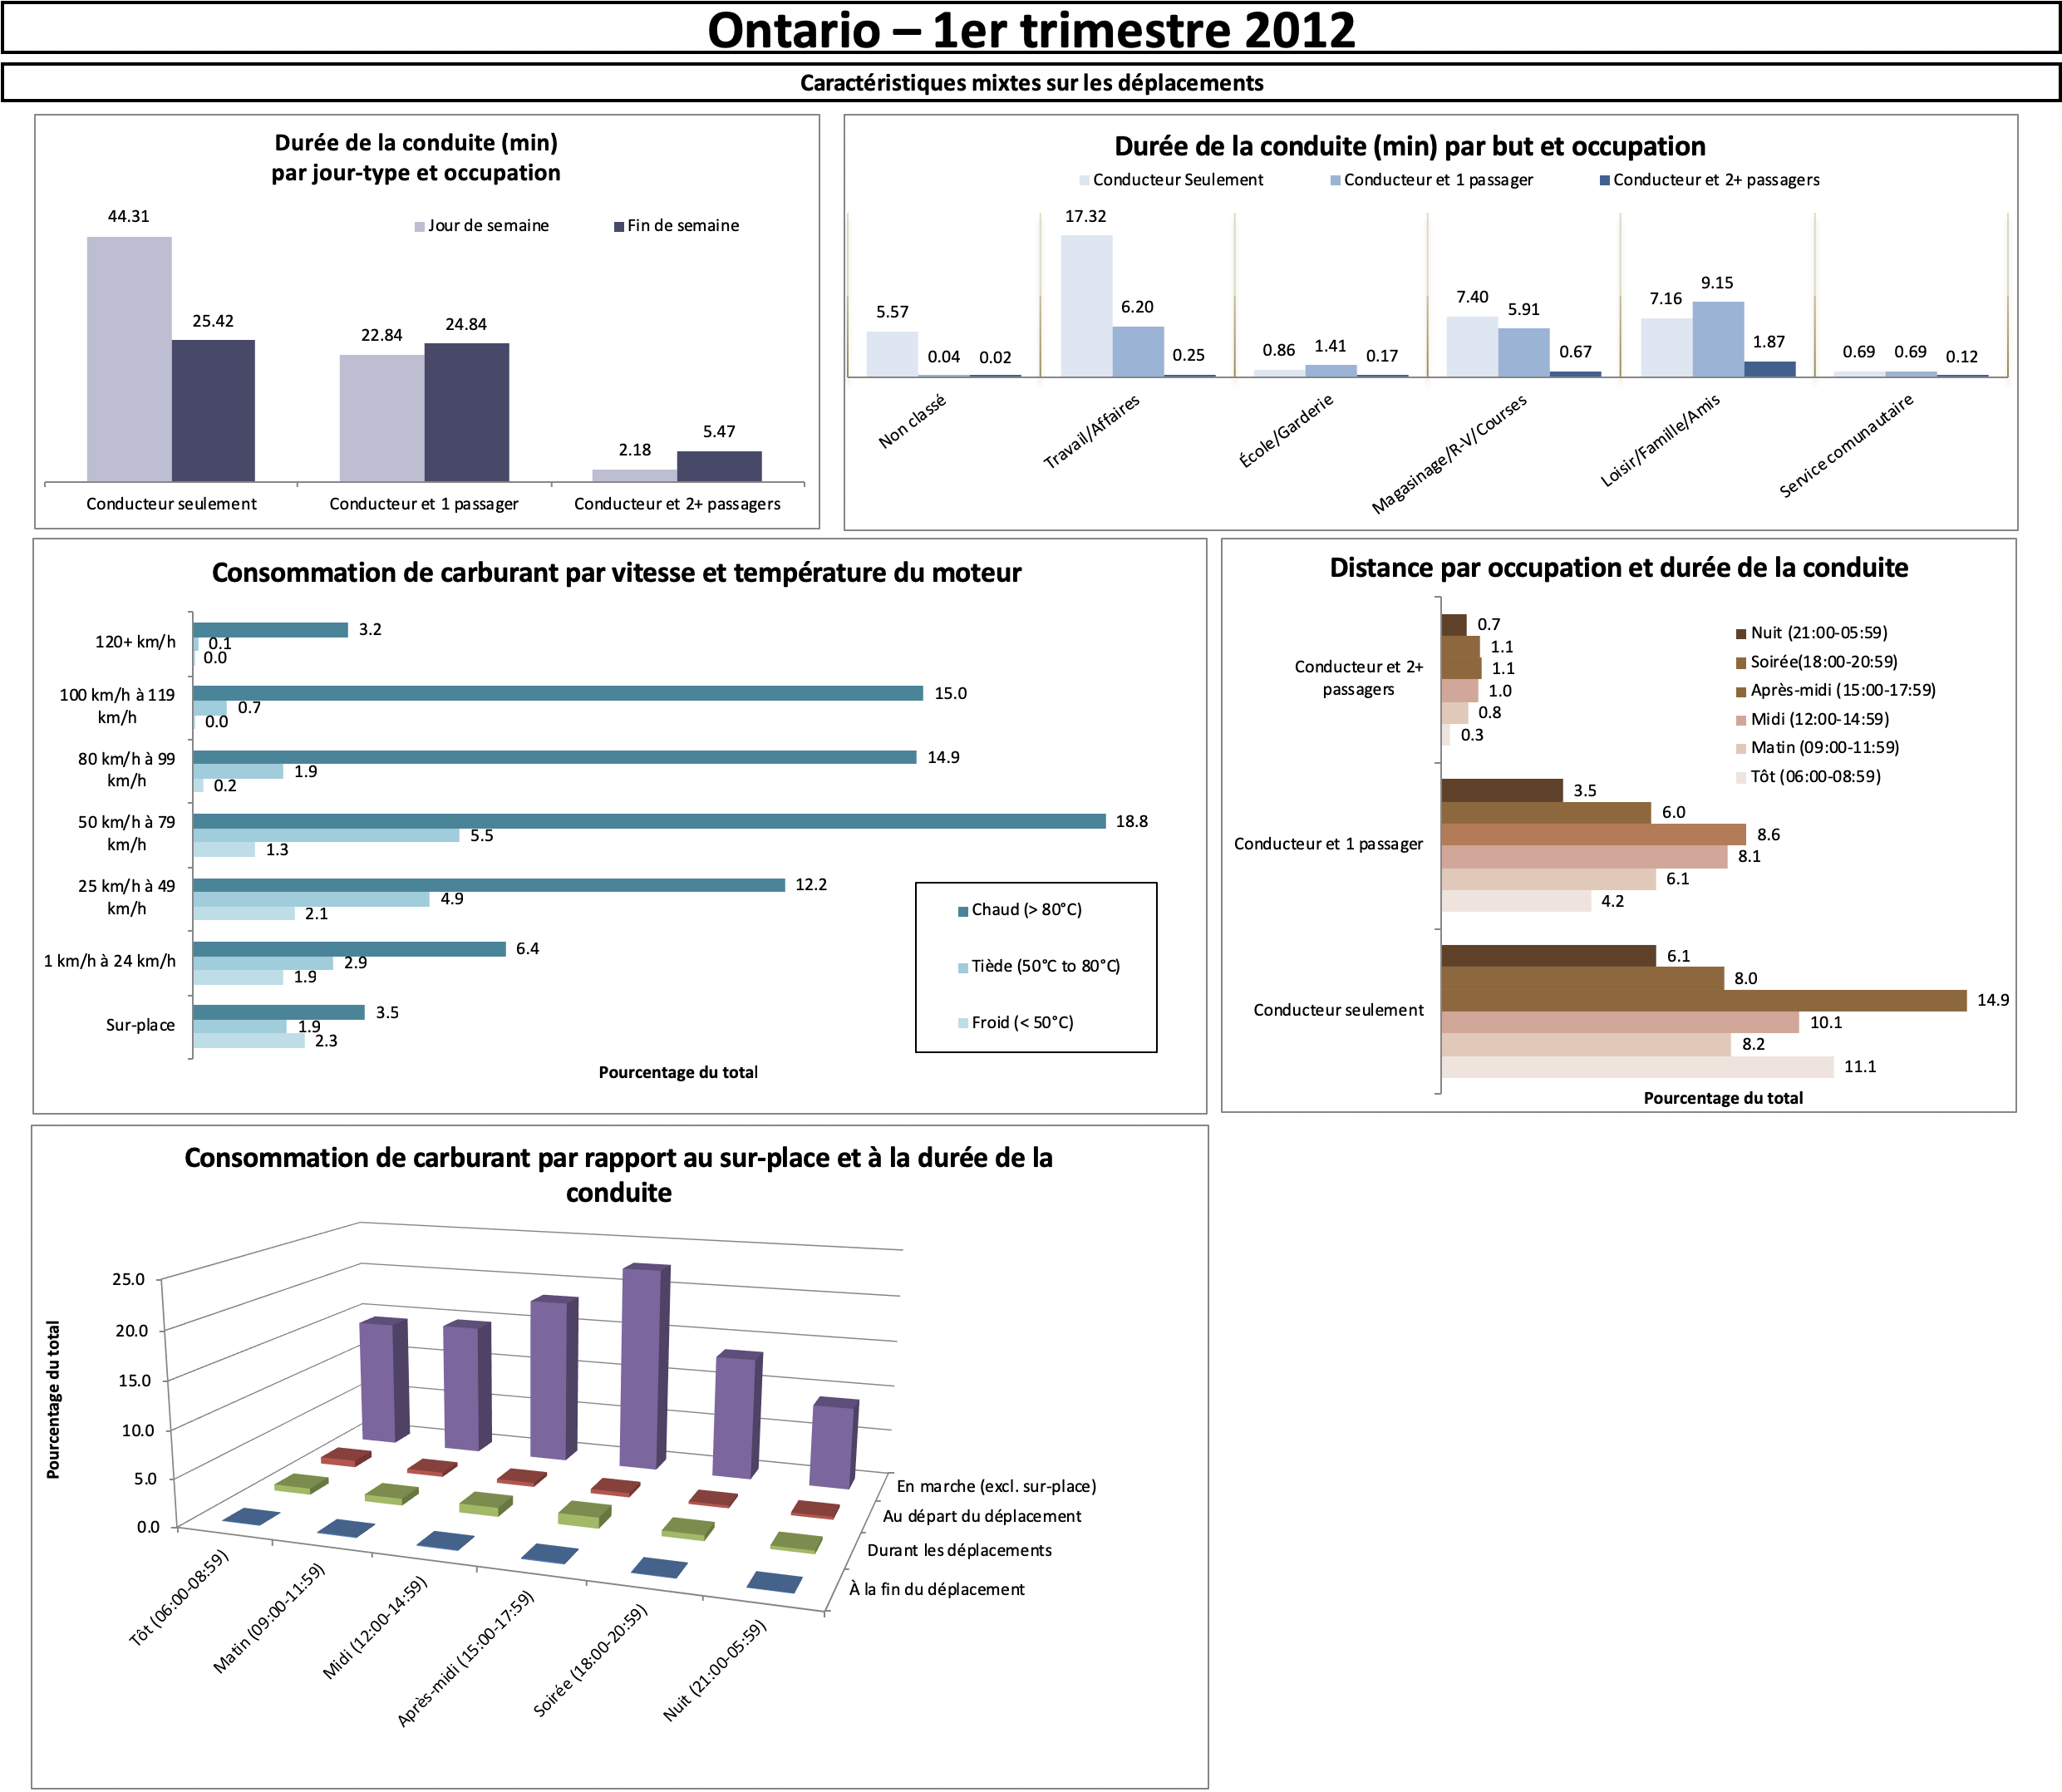
[Personal file]
Notes:
https://bigbookofdashboards.com/dashboards.html

Slide 46
LIMITATIONS
Dashboard #1: not glanceable, overuse of colour, pie charts??
Dashboard #2: 3D visualizations, distracting borders and background, lack of filtered data, insufficient labels and context
Dashboards #3: …

Slide 47
EXERCISE
In teams or individually, identify a scenario for which a dashboard could prove useful.
Determine specific questions that the dashboard could help answer or insights that it could provide.
Identify data sources and data elements that could be fed into your dashboard.
Design a display (with pen and paper) with mock charts.
What are the strengths and limitations of your dashboard? Is it functional? Elegant?

